Slide 1
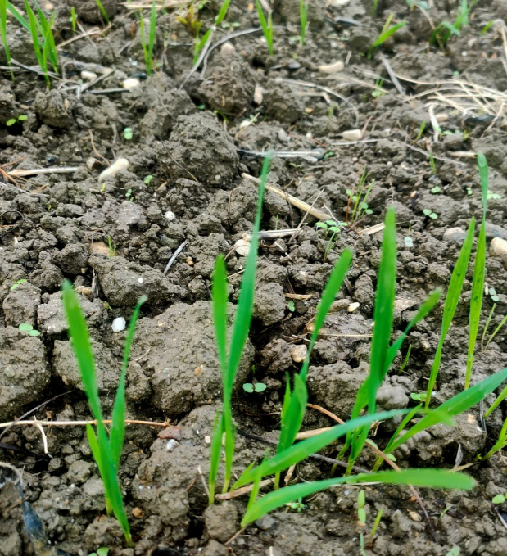
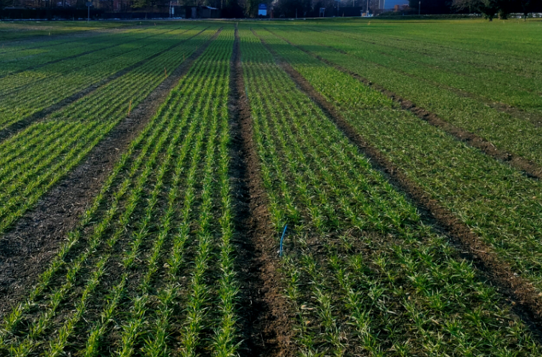
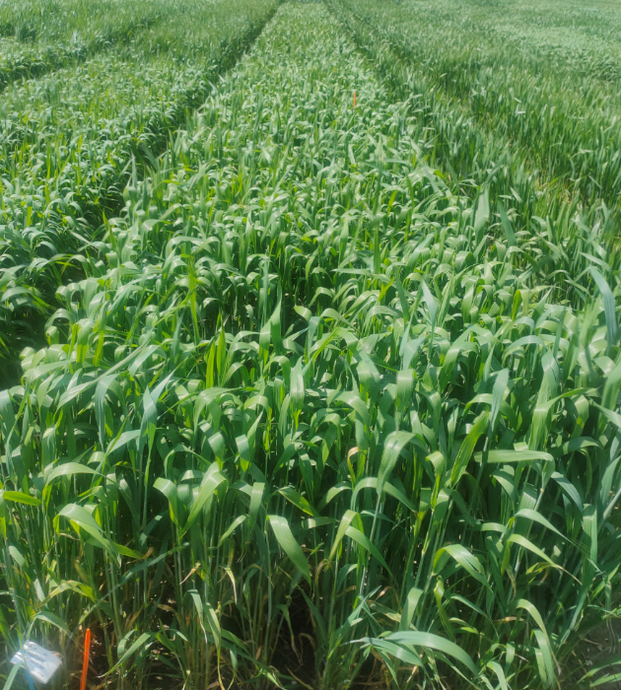
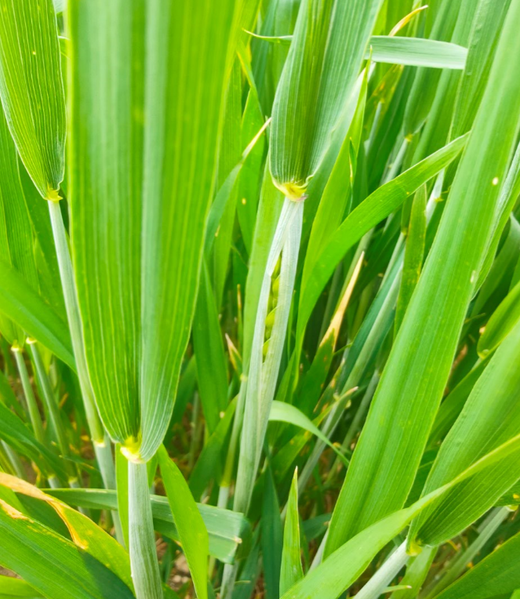

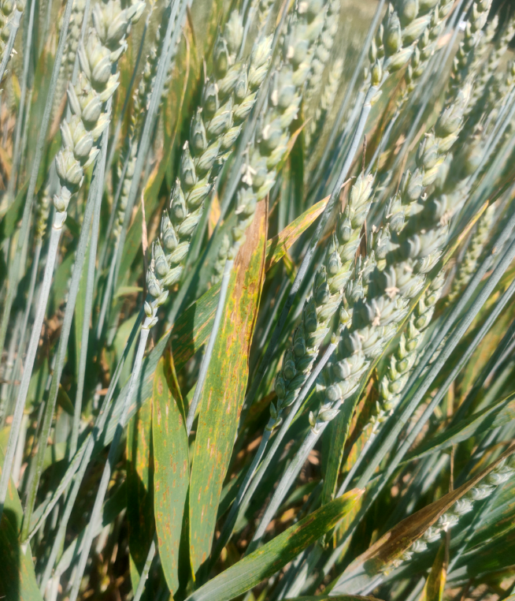
M2 statistical inference analysis on winter wheat variety trial
Nicolas Vuille-dit-Bille

Slide 2
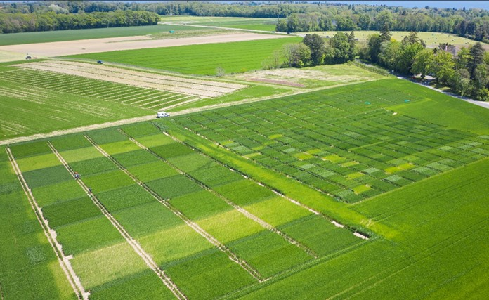
Agroscope: swiss federal institute for agricultural research
Group:
Cultivation Techniques and Varieties in Arable Farming
Team:
35 People
Domains of research:
Agronomy
Crop science
Main areas of work:
Characterization of genotypes of field crops
Improvement of management practices of field crops
Crop species:
Winter cereals (wheat, barley, oat, …)
Maize
Potato and Sugar beet
Oil crops and grain legumes
Minor crops (e.g. Quinoa, Amaranth)

Slide 3
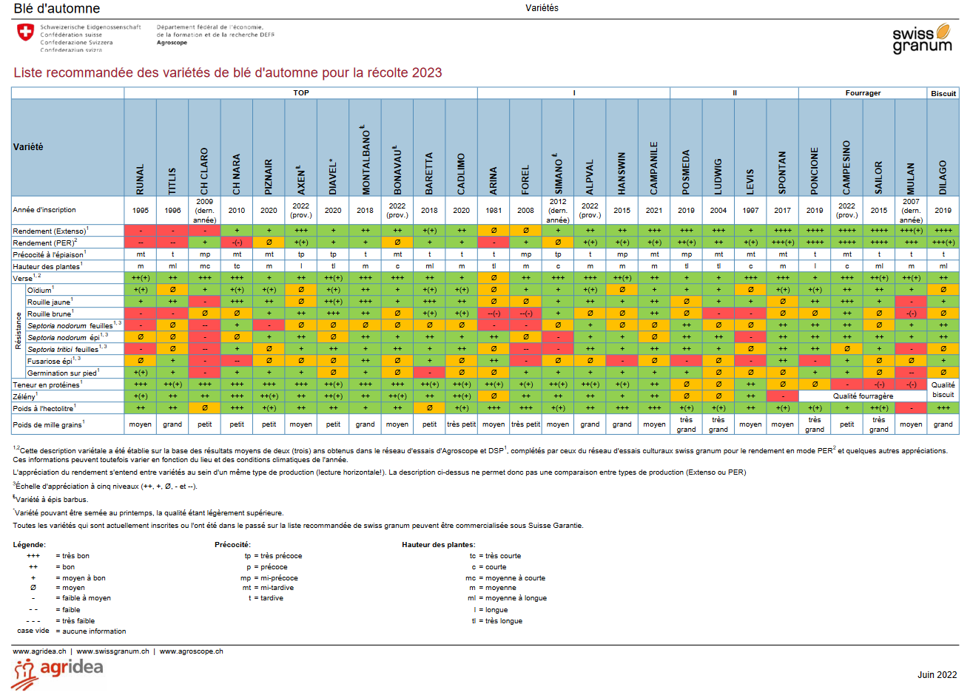
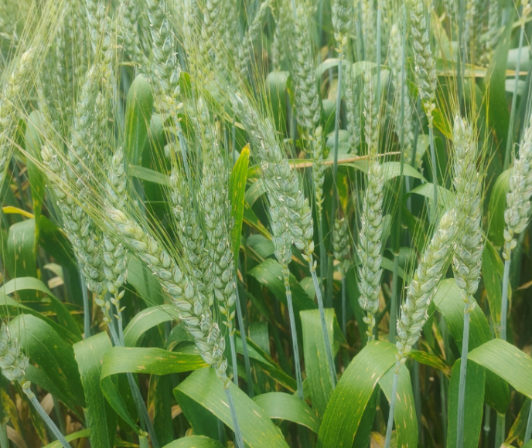
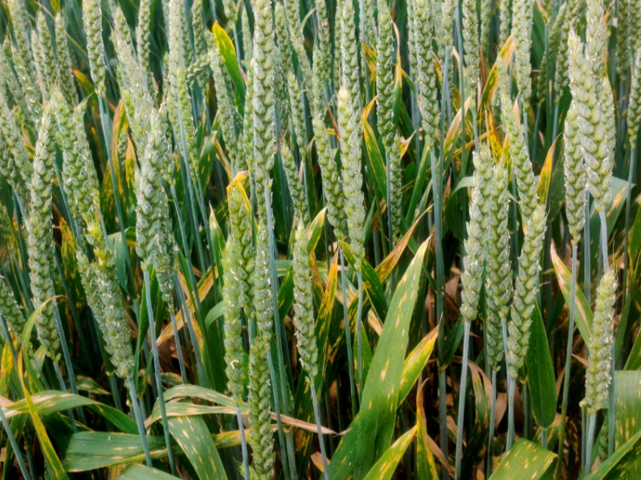
Variety trial context
Winter wheat varieties are tested on different experimental fields across Switzerland with different modality (low vs high inputs)
Each year, winter wheat varieties performance are reported and recommended to farmers according to a list
Challenge: not easy to estimate and understand accurately specific varieties response to specific environment linked to abiotic and biotic stresses (uncontrolled factors on the field)

Slide 4
Case study: variety trial with 2 treatments over 4 years
36 winter wheat varieties
4 years: 2021 to 2024
Case study context: study variety response to none vs conventional application
Find variety that are performing well also under limited available N in order to reduce N fertilization (economic and environmental cost)
2 treatments: conventional application of nitrogen (N) and no application of nitrogen
Measurement to estimate varieties performance:
Grain yield
Straw yield
Grain protein
Other physiological parameters (harvest index, leaf area index, chlorophyll content, canopy cover…)

Slide 5

Case study: field experimental design

Slide 6
Case study: experimental design
4 contrasted climatic conditions over 4 years
2 blocks corresponding to 2 treatments (conventional and no N treatment) within field
36 wheat varieties (3 rep by block)
Year
2021
2022
2023
2024
N treatment
N conventional
N0
N conventional
N0
N conventional
N0
N conventional
N0
N reduced
Variety
36 varieties
(3 rep)
36 varieties
(3 rep)
36 varieties
(3 rep)
36 varieties
(3 rep)
36 varieties
(3 rep)
36 varieties
(3 rep)
36 varieties
(3 rep)
36 varieties
(3 rep)
36 varieties
(3 rep)

Slide 7
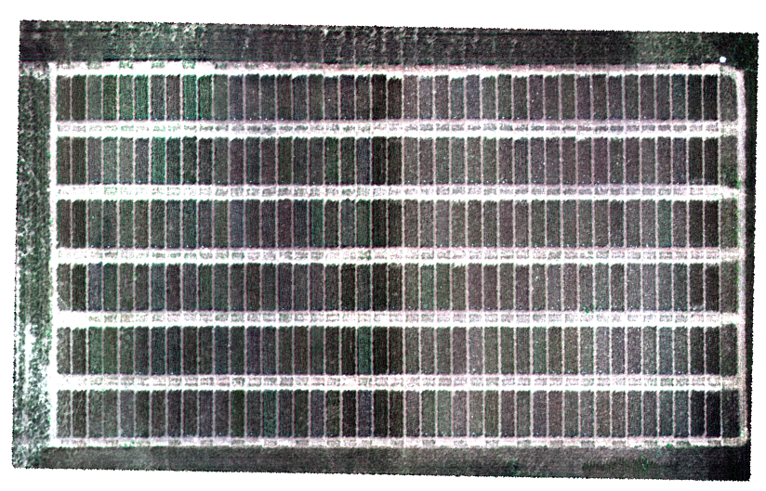
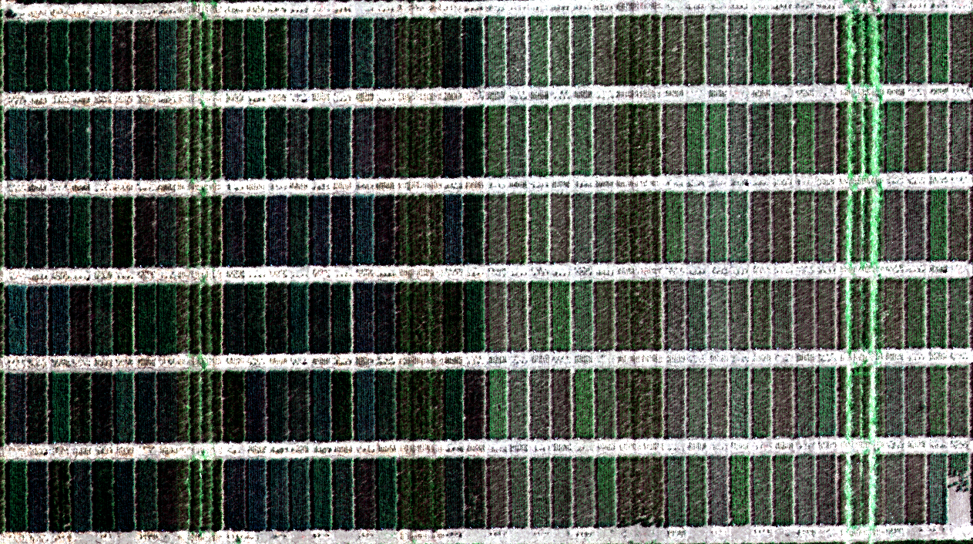

Case study: field trials over 4 years
Conventional N
N0
Conventional N
N0
2021
2022
Conventional N
N0
2023
Conventional N
N0
2024

Slide 8
Data preparation
The varieties tested are not always the same over years
Find common varieties tested over 4 years
The measurements to evaluate the variety performance are not always the same over years
Find common variables measured over 4 years
Due to experimental issue some values are lost and one replicate less can imbalance the statistical analysis (especially with rep=3)
Remove varieties with not sufficient replicates
Datasets are stored by years on excel sheet
Merge datasets for over years analysis and visualisation

Slide 9
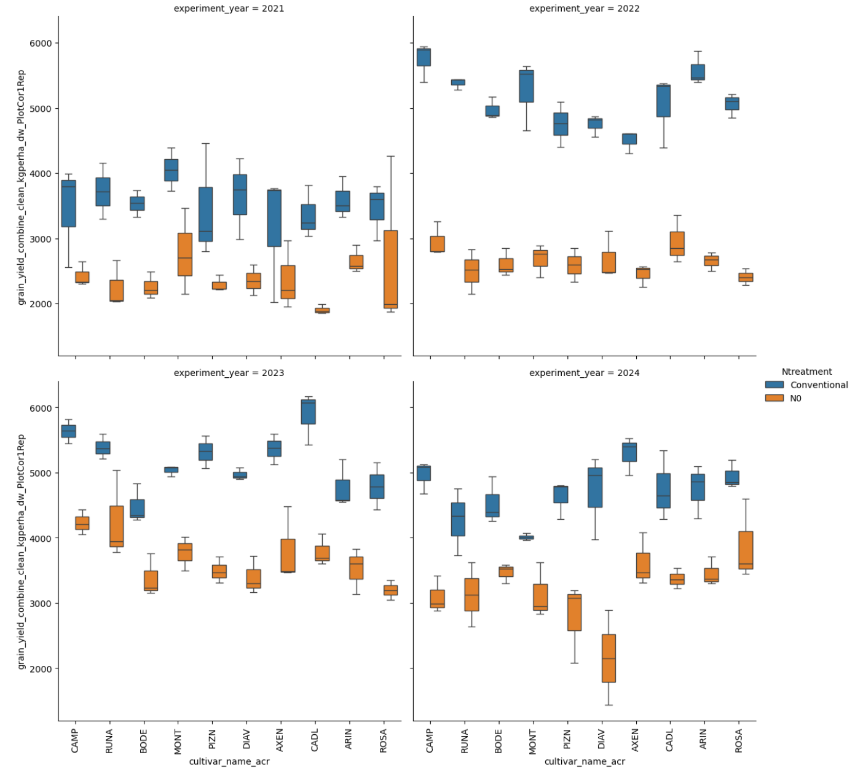
Estimate statistical differences between varieties at N treatments and years level: grain yield
Conventional N treatment: higher grain yield
high effect in 2022 (dry year)
Varieties: grain yield performance depending on years an N treatment blocks

Slide 10
Model parameters
Response variable: grain yield
3 factors as explanatory variables:
Varieties : 10 levels
N treatment: 2 levels (N0, Conventional)
Years: 4 levels (2021-2024)
H0: there is no difference of grain yield between varieties.

Slide 11
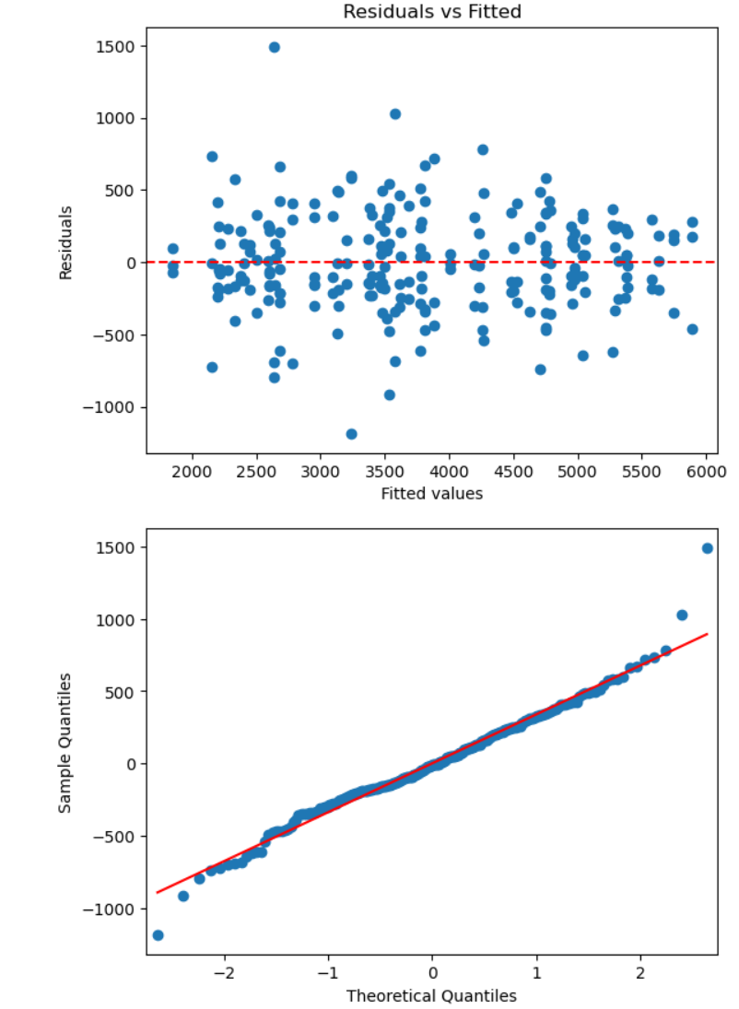
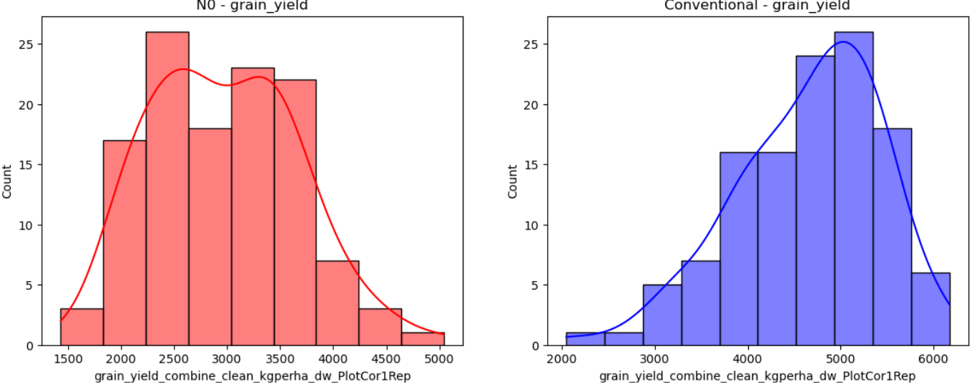
Statistical test option (> 2 groups): ANOVA
Model assumptions:
Independence of observations
Normality
Homogeneity of variances (homoscedasticity)
Shapiro-Wilk test p-value: 0.0067

Slide 12
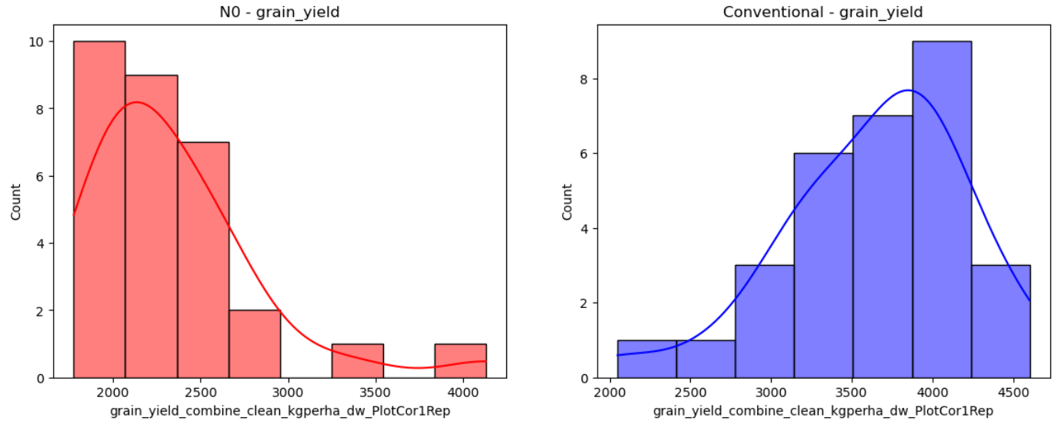
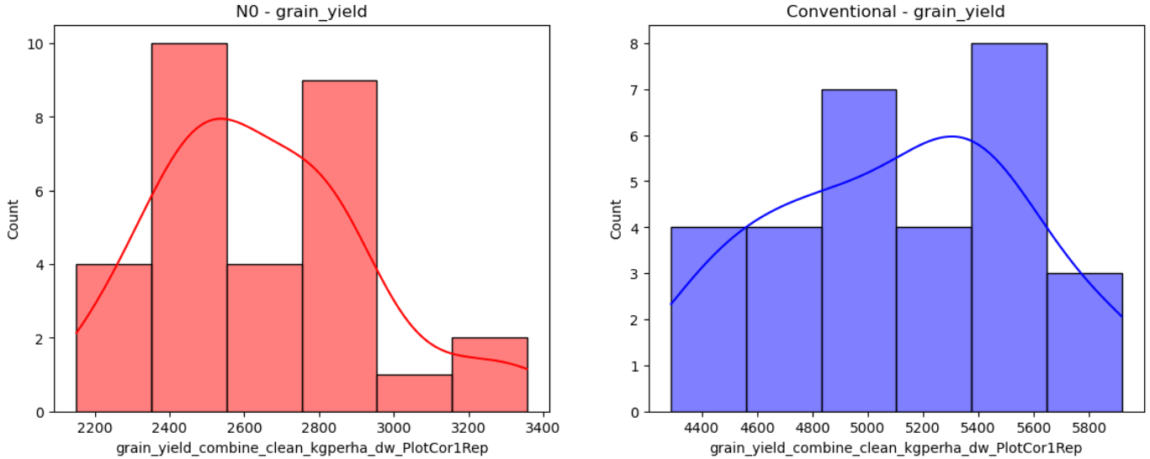
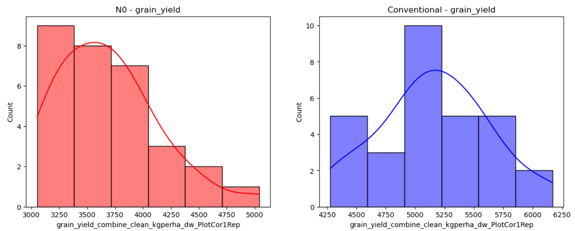
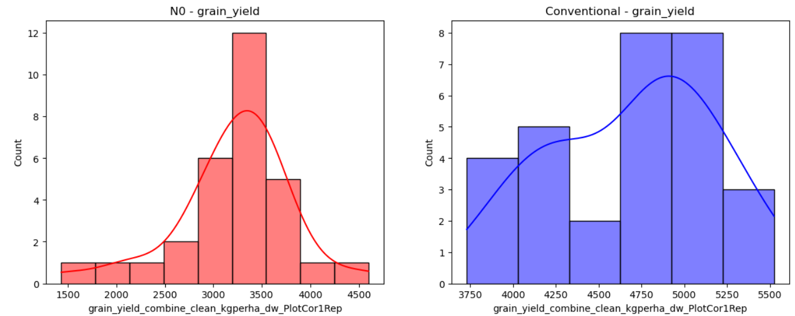
Data distribution by year and N treatment block
2021
2022
2023
2024

Slide 13
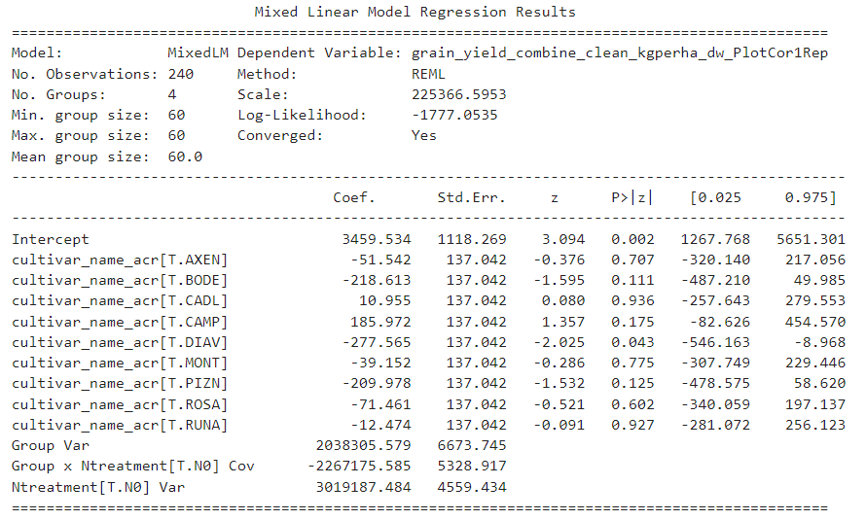
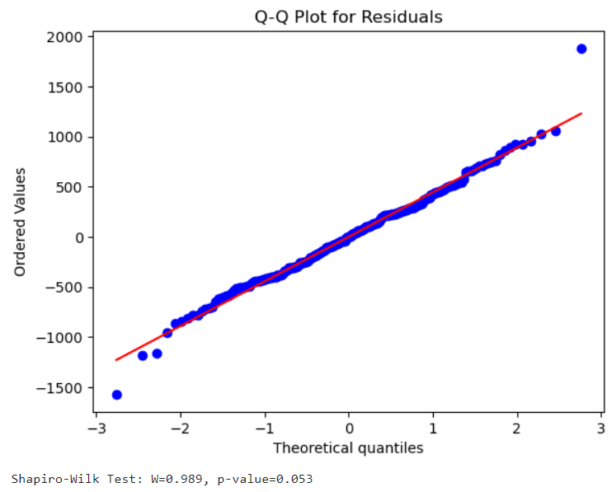
Linear mixed model
Handles lack of independence of observations
Fixed effects: varieties
Random effects: N treatments nested in years factor
(account for correlation between observations within the same treatment block)
Python formula:
Model = smf.mixedlm("grain_yield_combine_clean_kgperha_dw_PlotCor1Rep ~ cultivar_name_acr", data=merged_df, groups=merged_df["experiment_year"], re_formula="1 + Ntreatment")
Normality of residuals ?

Slide 14
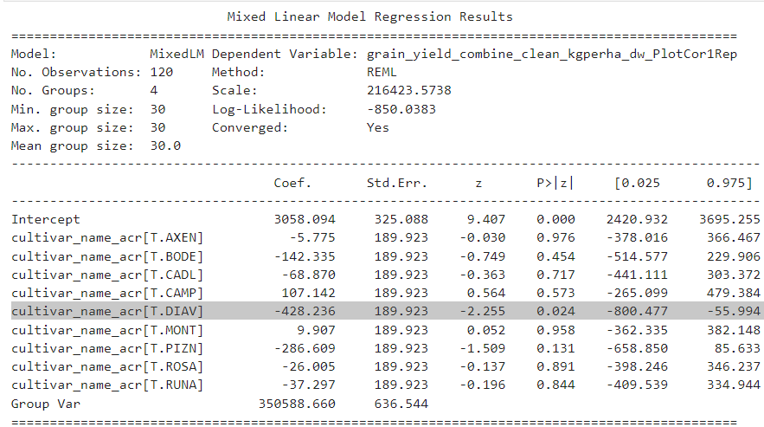
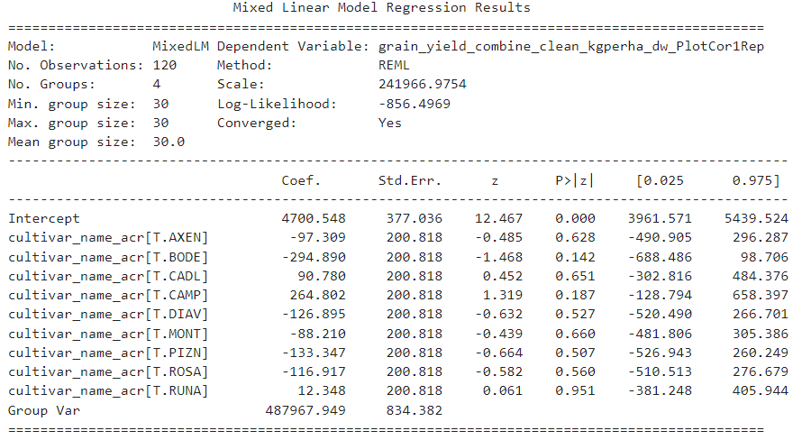
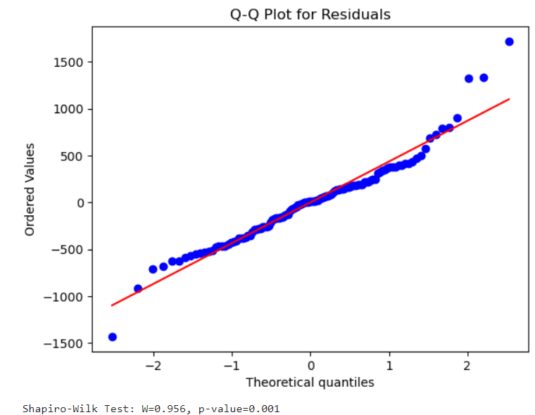
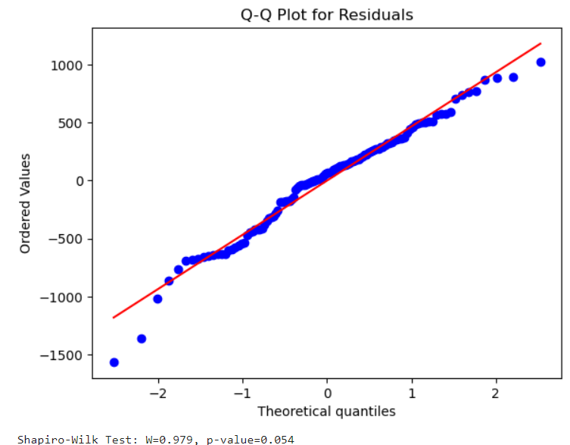
Fit linear mixed models for each N treatments
A lot of variability seems not explained by the fixed effects (year effect).
At this level, no significant differences between varieties are found
Use N treatments blocks as separate experiment and analyse variety differences within year (random facror)
N0
Conventional N

Slide 15
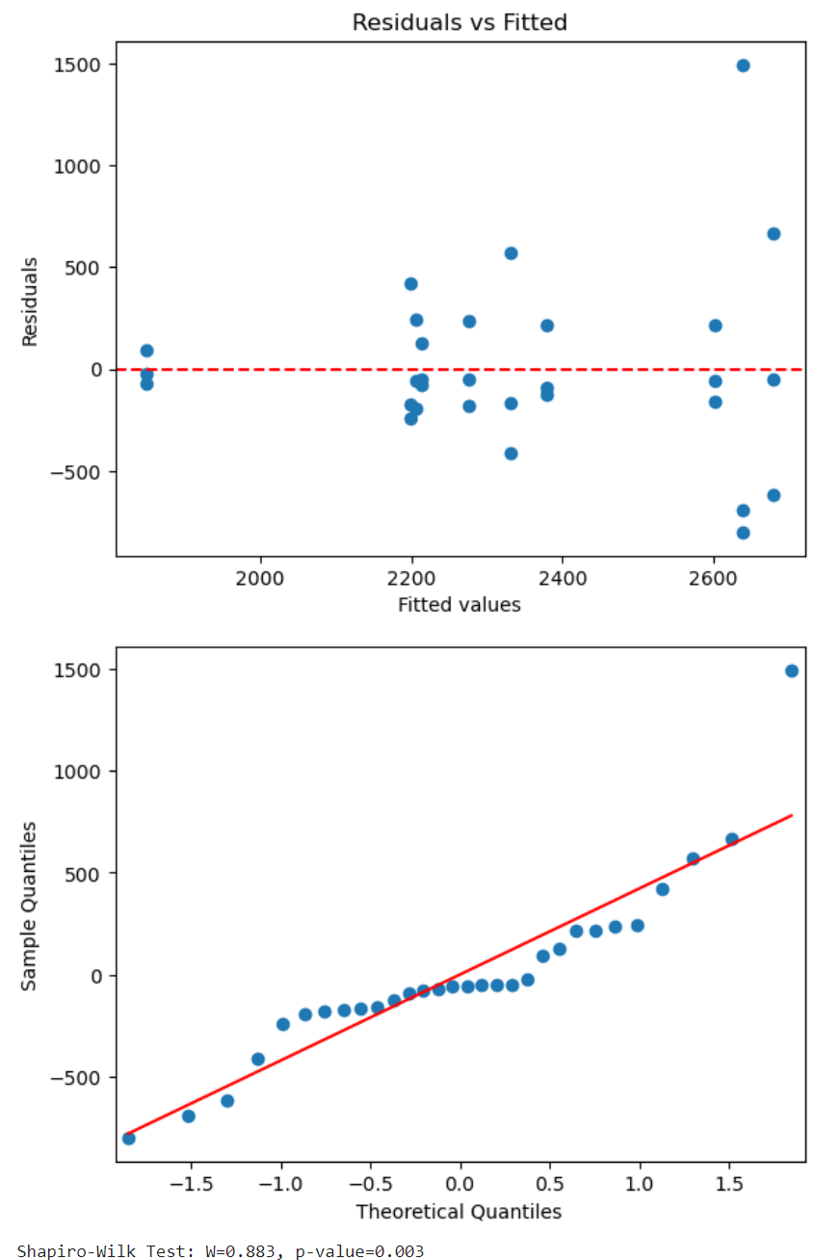
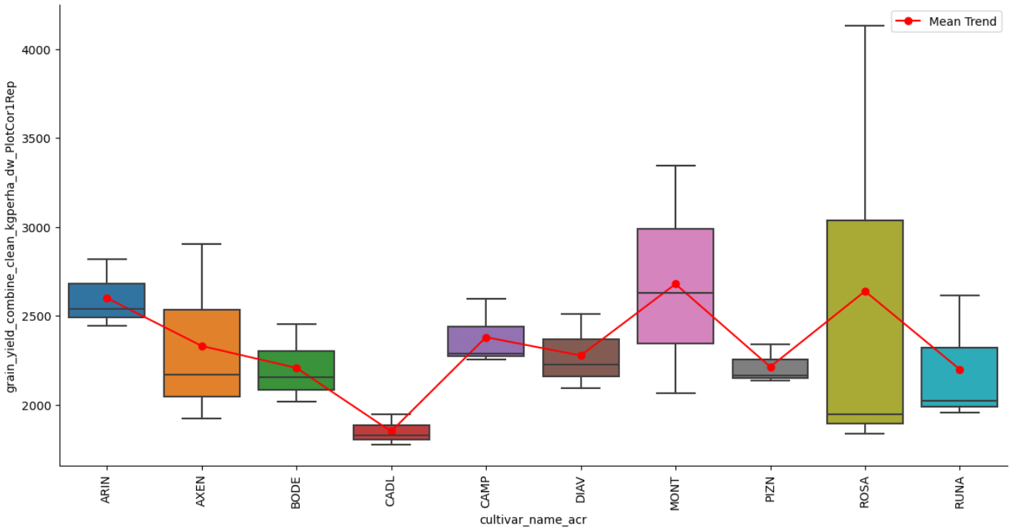
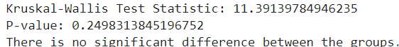
N0 analysis: 2021

Slide 16
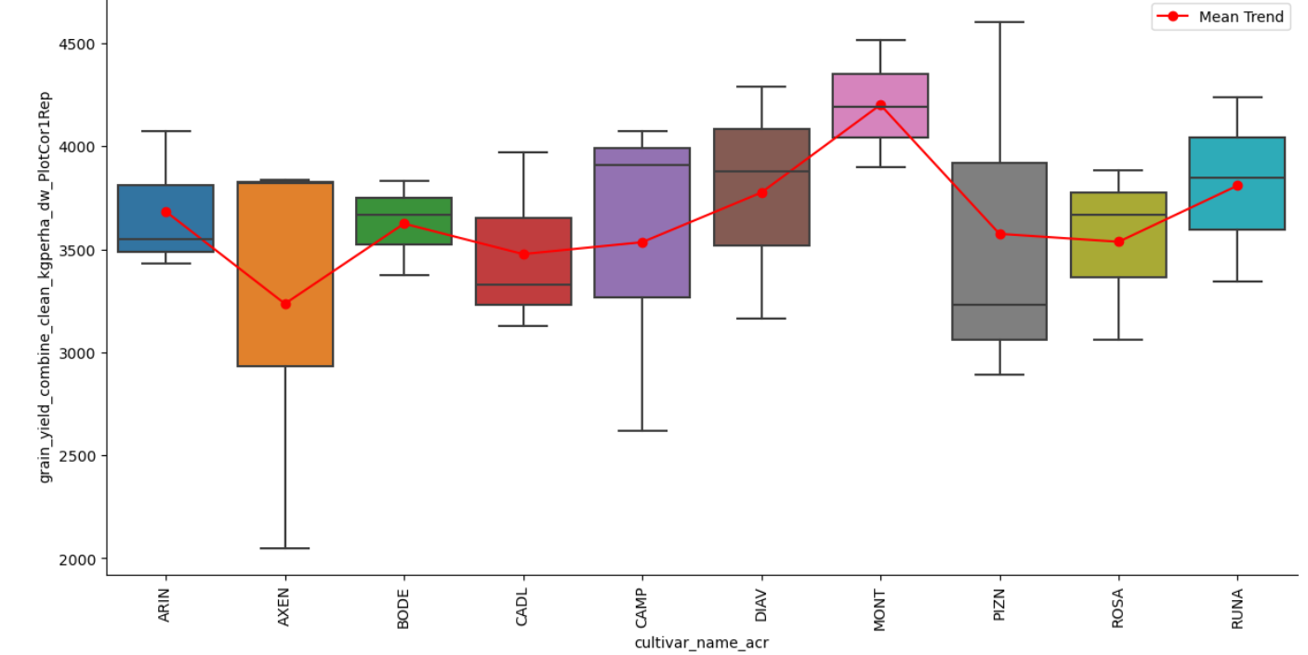
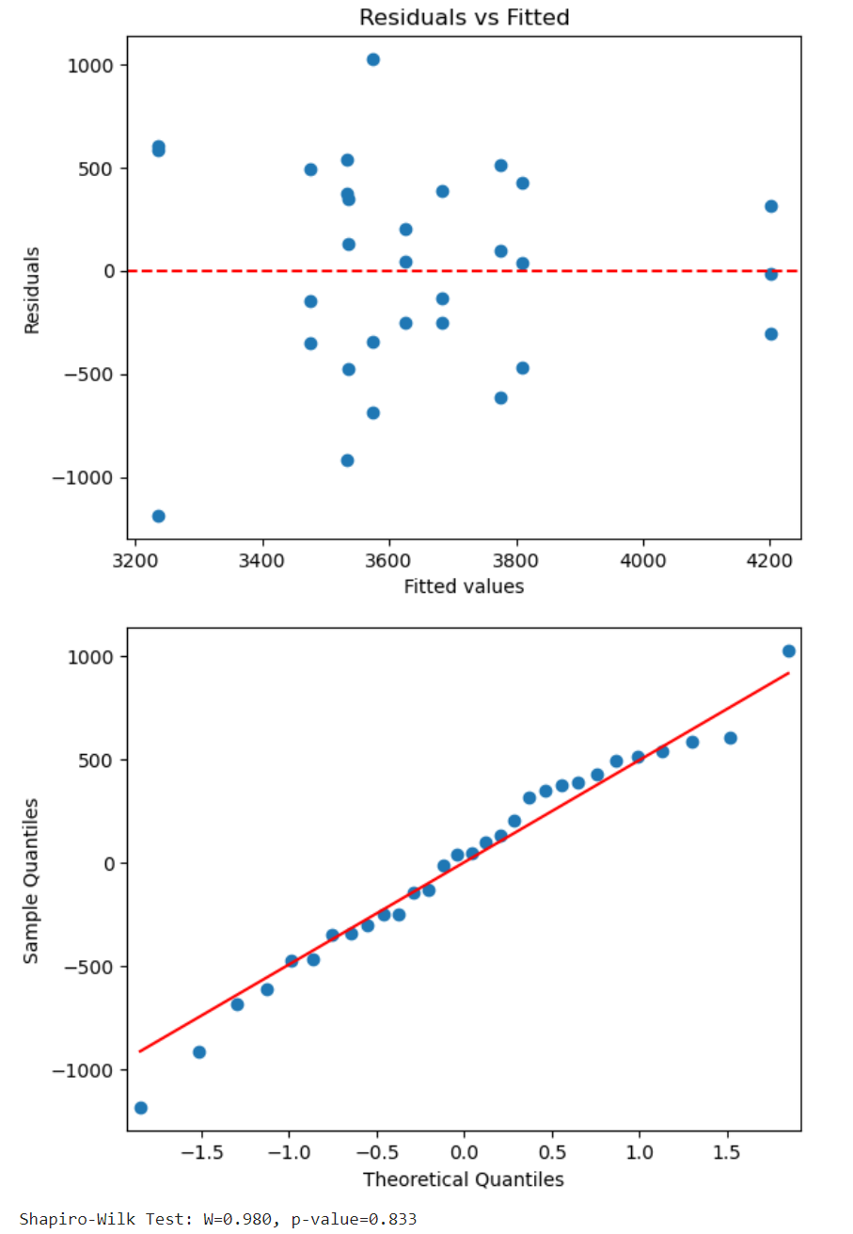
Conventional N analysis: 2021

Slide 17
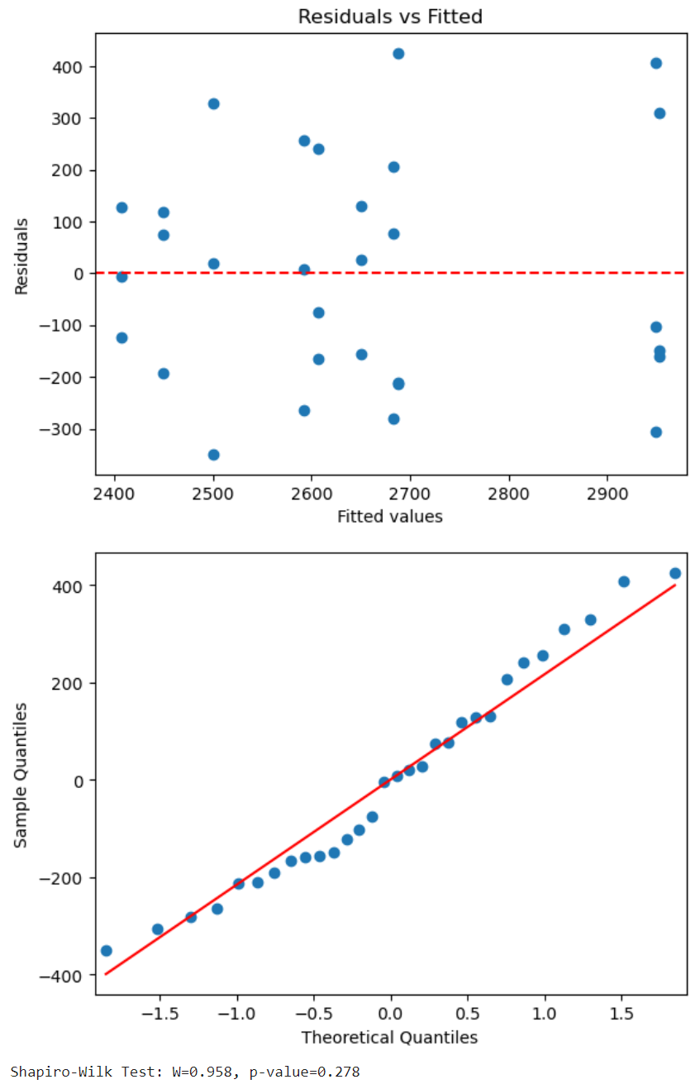
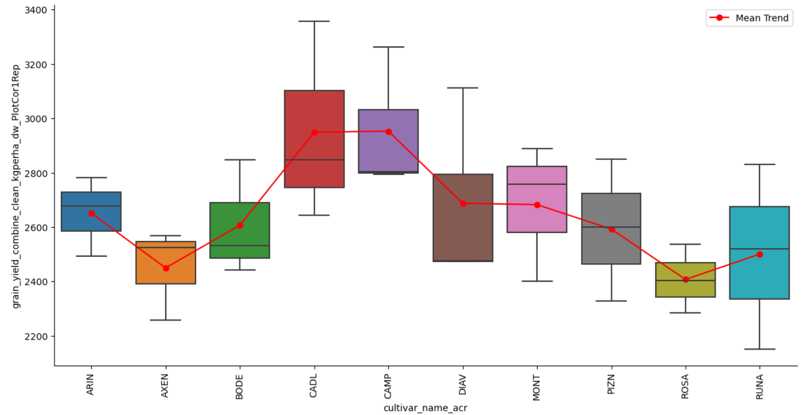
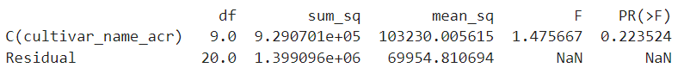
N0 analysis: 2022

Slide 18
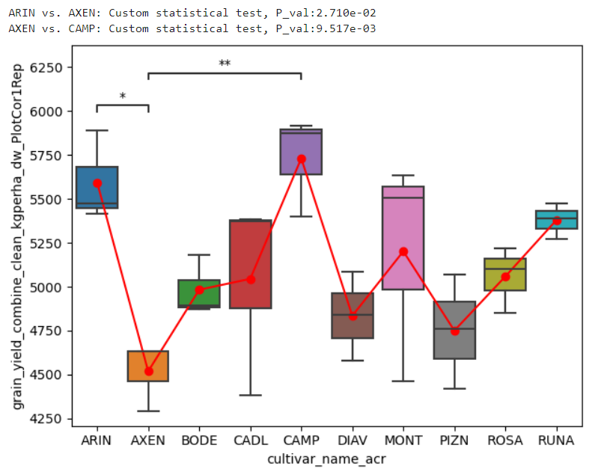
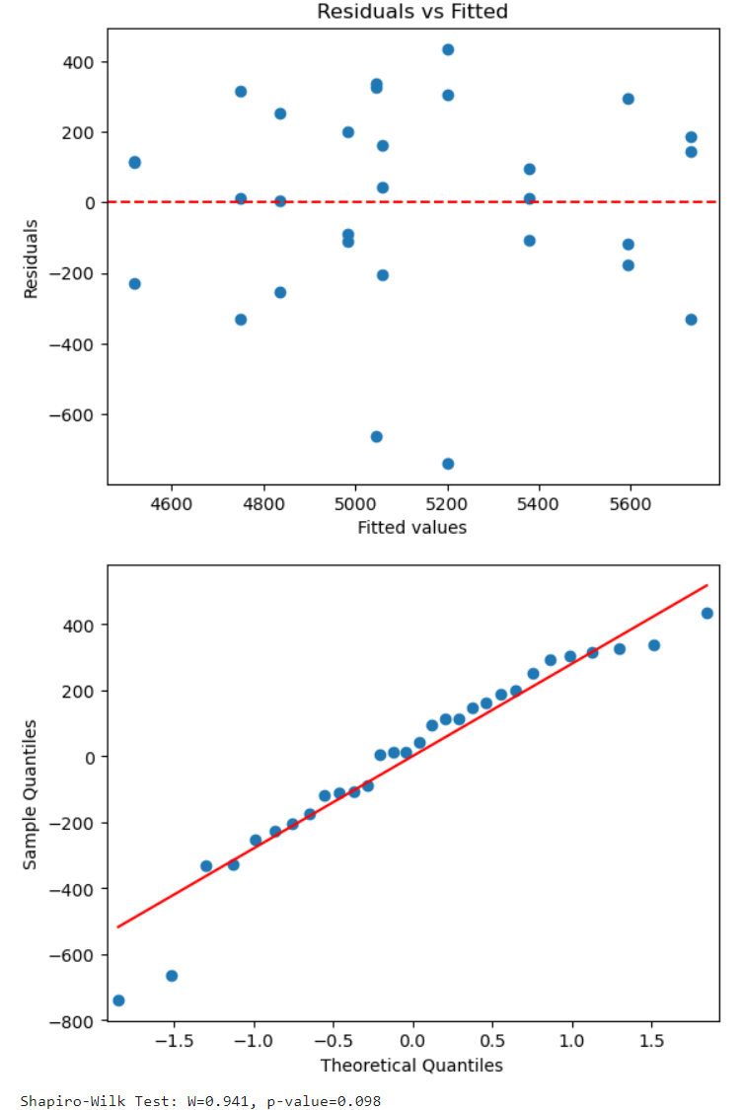
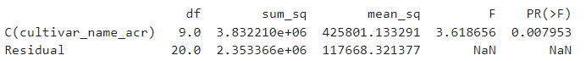
Conventional N analysis: 2022

Slide 19
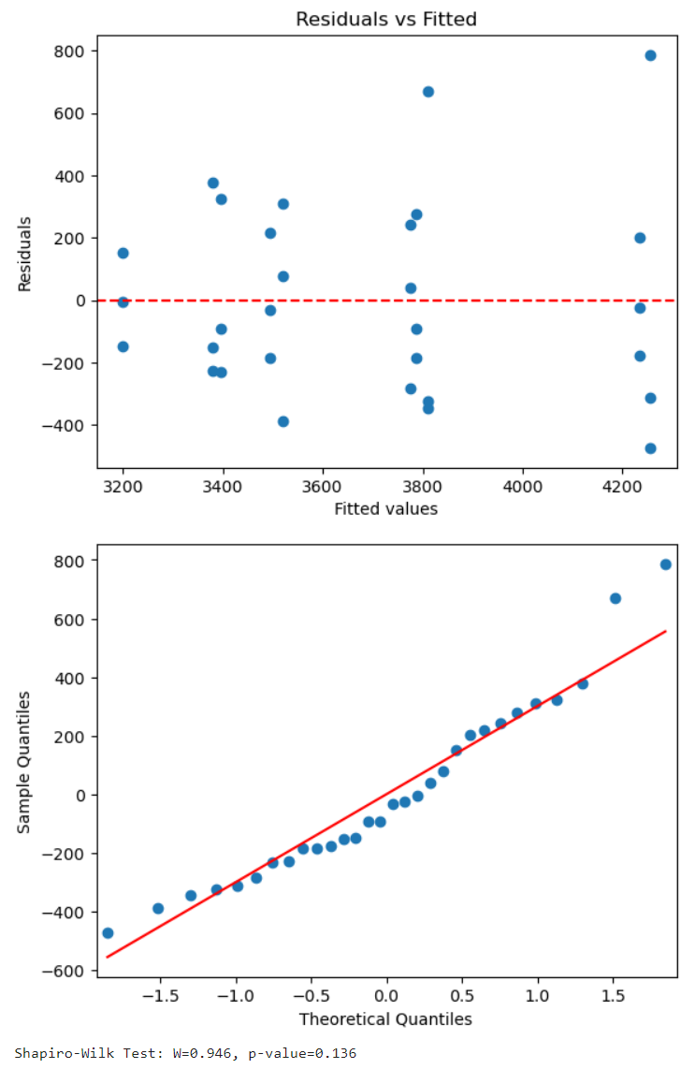
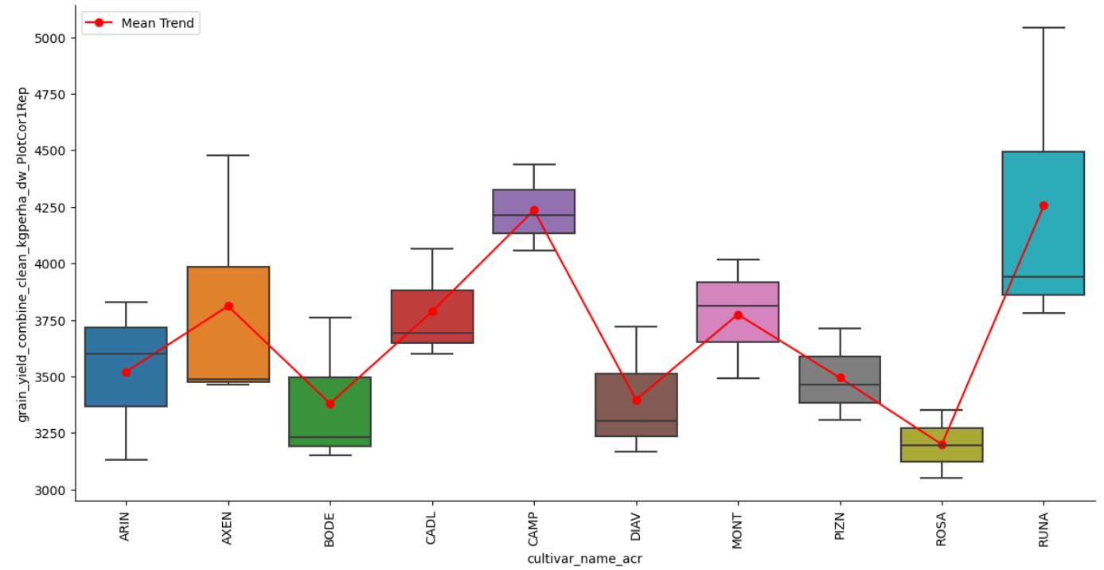
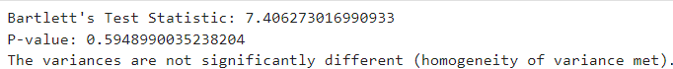
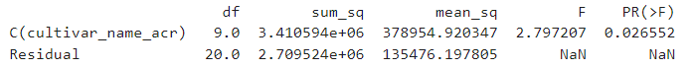
N0 analysis: 2023

Slide 20
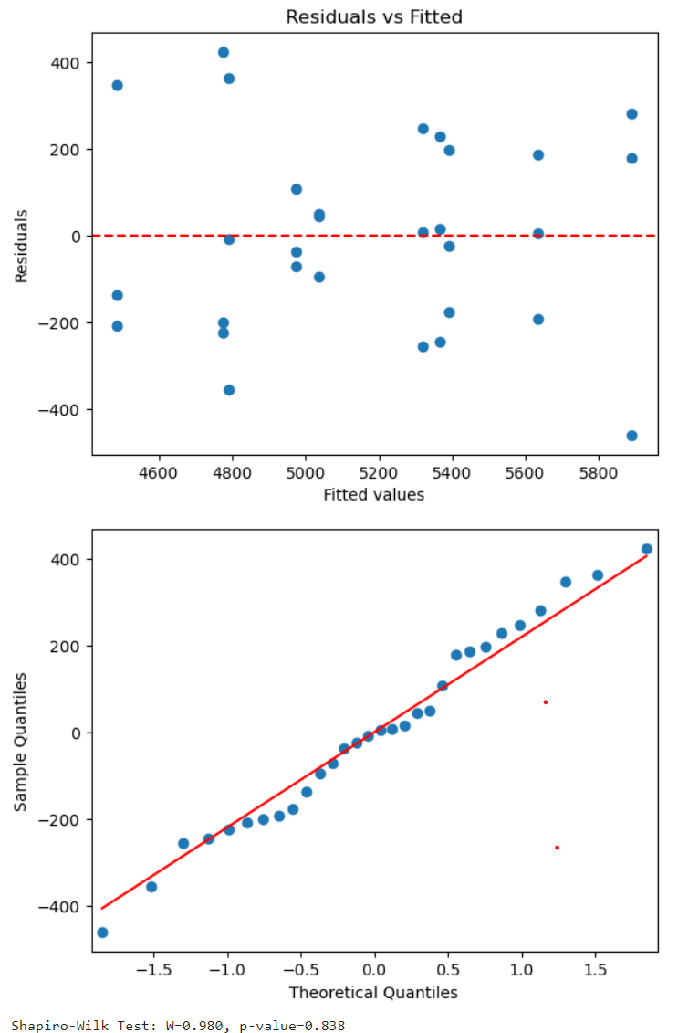
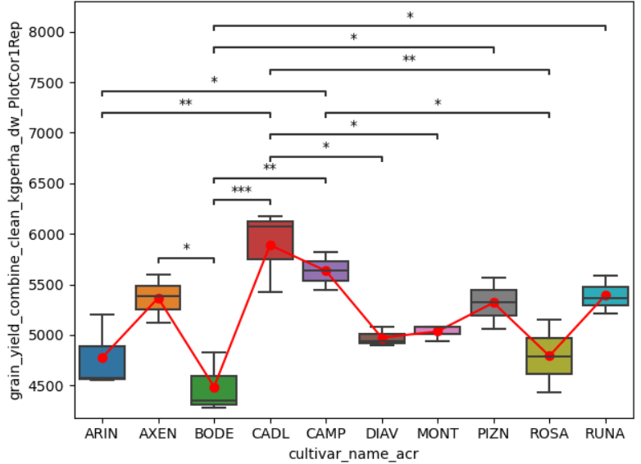
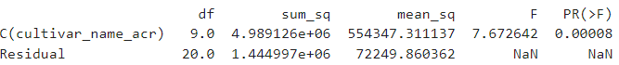
Conventional N analysis: 2023

Slide 21
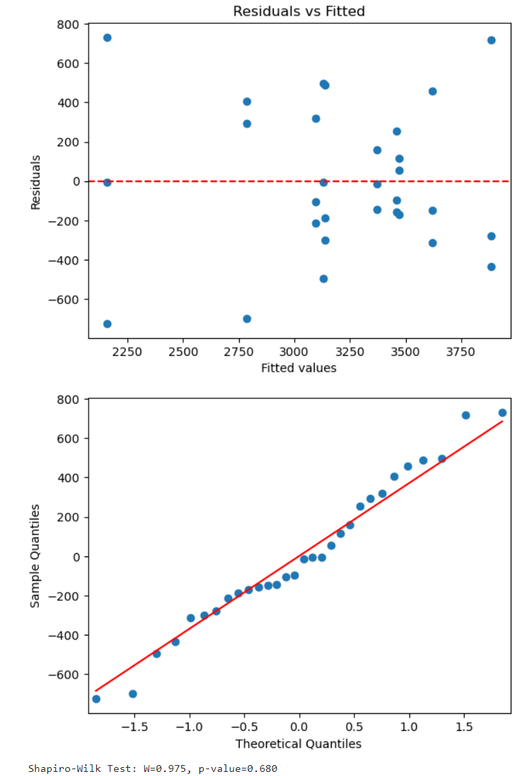
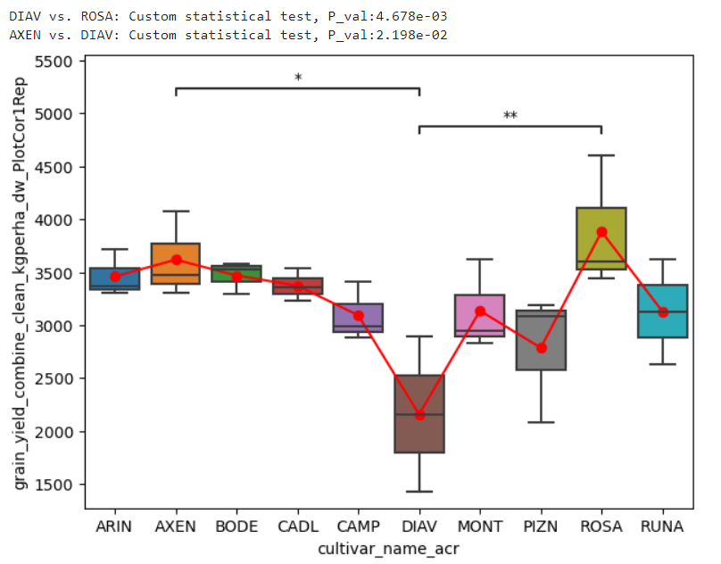
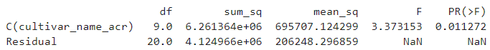
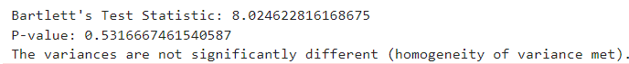
N0 analysis: 2024

Slide 22
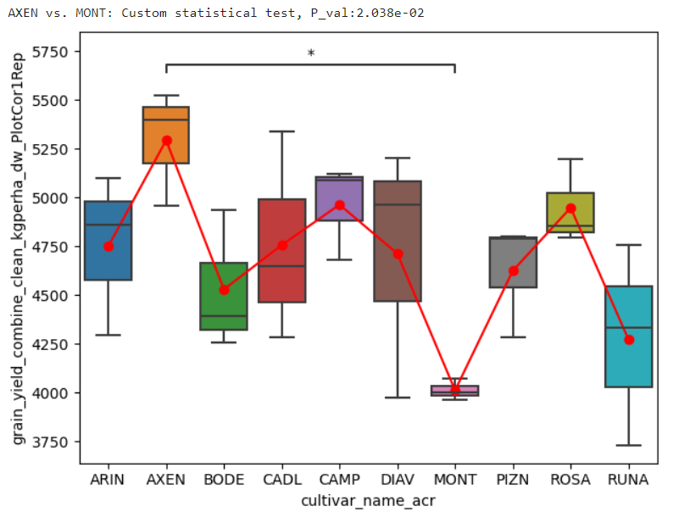
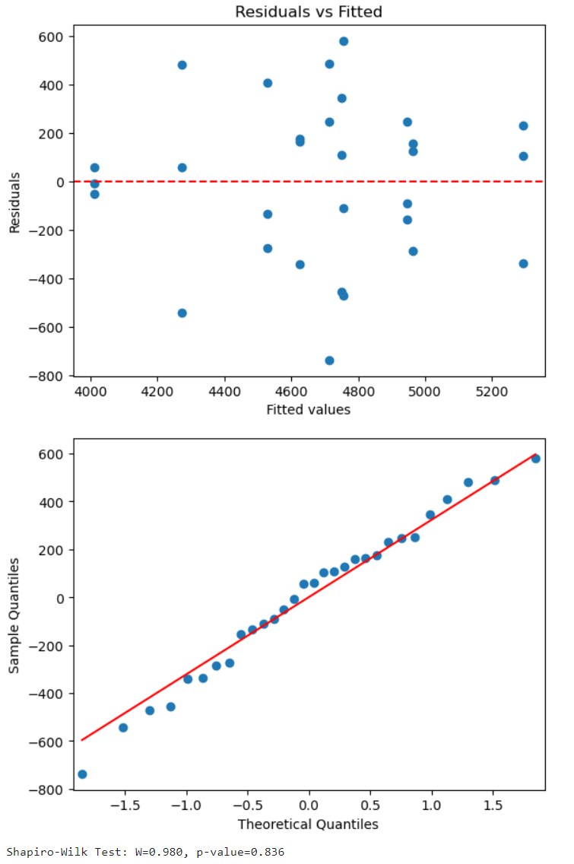
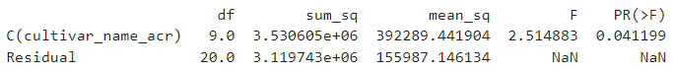
Conventional N analysis: 2024

Slide 23
Summary: statistical differences between varieties
Conventional N - 2022
Conventional N - 2023
2021: grain yield too low – no significant differences found between varieties in both N treatment block.
N0: no significant differences found, except in 2024.
Campesino variety: consistent high grain yield over years and significantly different from other varieties.
Axen variety: high grain yield (2023 and 2024) with significant differences from other varieties but seemed sensible to not optimal growth condition (2021 and 2022).
N0 - 2024
Conventional N - 2024

Slide 24
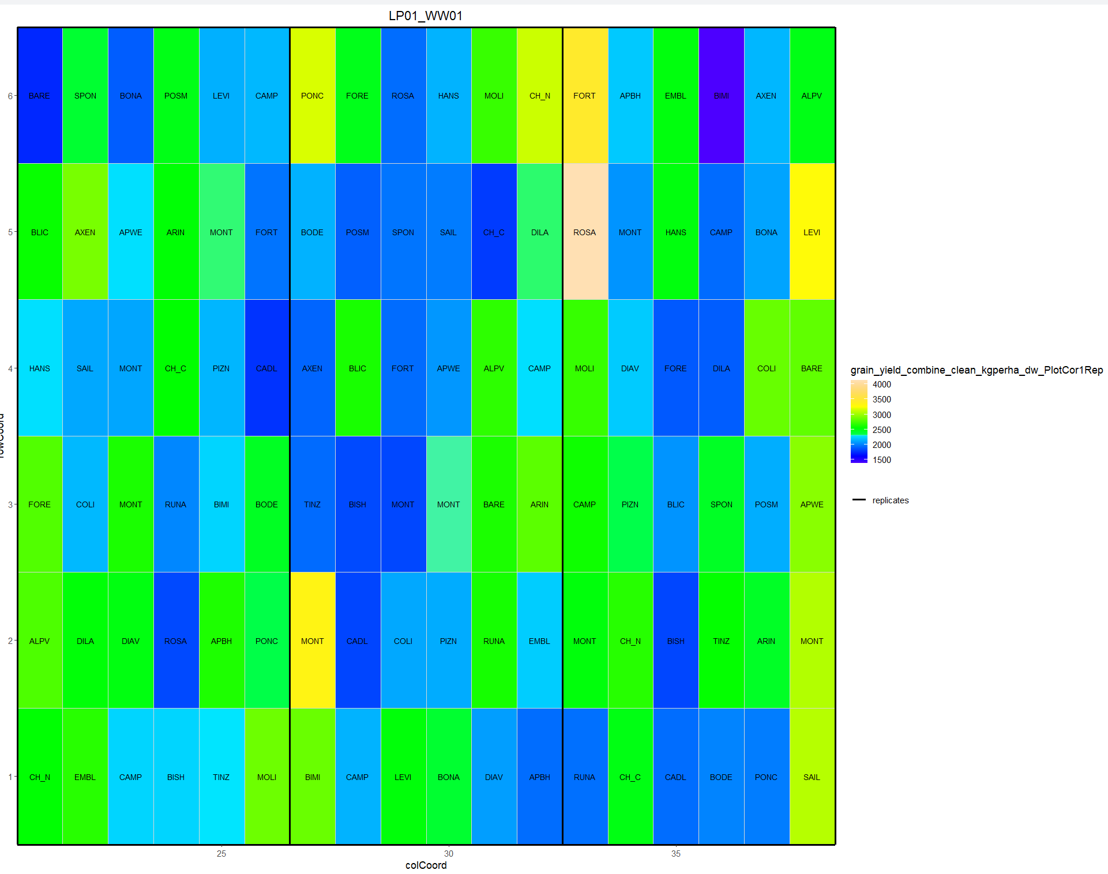

Spatial heterogeneity: source of variance: 2021 (N0)
H² = 0
Correcting spatial trend did not increase variance part explained by the variety

Slide 25


N0 analysis: spatial correction in 2021
Before correction
After correction

Slide 26


Spatial heterogeneity: source of variance: 2024 (N0)
H² = 0.84
Correcting spatial trend increased variance part explained by the variety

Slide 27


N0 analysis: spatial correction in 2024
Before correction
After correction

Slide 28
Conclusion
Field data: can be noisy:
Difficult to highlight statistical differences between variety
Low statistical power (3 replicates)
Spatial correction could be used (Spat package from R) to reduce noise regarding field spatial heterogeneity
Field experimental design not optimal to study interaction between N treatment and variety:
Limited to field practical resource
Dependence of observations within blocks
Other trials with less varieties are used to investigate this interaction with optimal field trial design
Difficult to find statistical differences when most of values are low (N0 block treatment):
2024: reduced N block (only one year of experiment)
Other agronomic parameter could be analysed to really understand how the variety response is interacting with specific environment and climatic conditions
Straw yield (positively correlated with grain yield)
Harvest index (indicates the ratio of grain on total plant weight (grain + straw)
Protein in grain (negatively correlated with grain yield)
Plant height (positively correlated with grain and straw yield; lodging effect)
Disease (can explain unexpected low yield)

Slide 29

Thank you for your attention
Nicolas Vuille-dit-Bille nicolas.vuille-dit-bille@agroscope.admin.ch
Agroscope good food, healthy environment
www.agroscope.admin.ch

